Slide 2
Group 2
Members
Parrilla
Singson
Flordeliza
Cepe (corres)
Obias (corres)
Dela Carcel (corres)

Slide 3
Fuzzy Membership
Write a Java Code that will evaluate the Membership Function
Input: Temperature and Cloud Cover

Slide 4
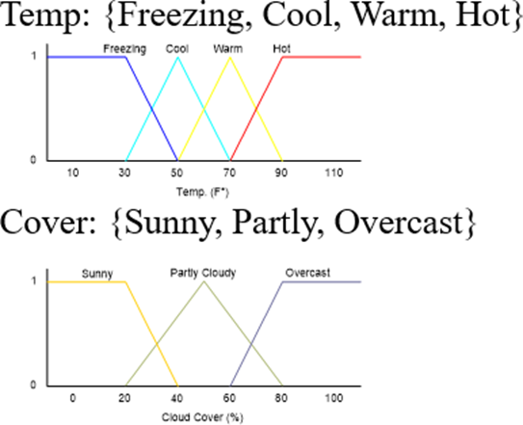
Temperature

Slide 5

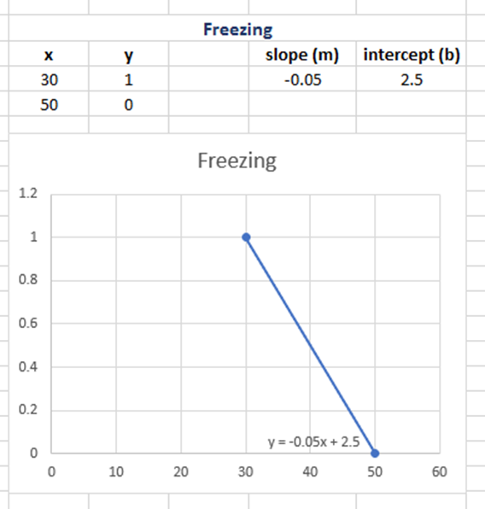
Temperature: Freezing
CONSTANT
#define Freeze_Slope (-0.5);
#define Freeze_Offset (2.5);

Slide 6
private final static double FREEZING_SLOPE = -0.05; private final static double FREEZING_OFFSET = 2.5 ;

Slide 7
double FreezingMF (double temp)
{
double mf = 0;
if((temp >= 0) && (temp < 30))
{
mf = 1;
}
else if (temp >= 50)
{
mf = 0;
}
else if((temp >= 30) && (temp < 50))
{
mf = (Freeze_Slope * temp) + Freeze_Offset;
}
return mf;
}
temp >=0 && temp <30
temp >= 30 && temp < 50
temp >= 50

Slide 8
public double freezingGetMf(double temp){ double mf=0; if((temp<30)&&(temp>=0)){ mf=1; } else if(temp>=50){ mf=0; } else if((temp>=30)&&(temp<50)){ mf=FREEZING_SLOPE * temp + FREEZING_OFFSET; } return mf; }//freezingGetMf

Slide 9

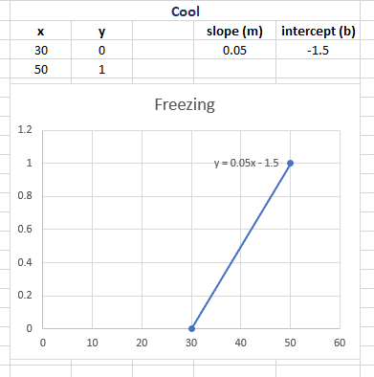
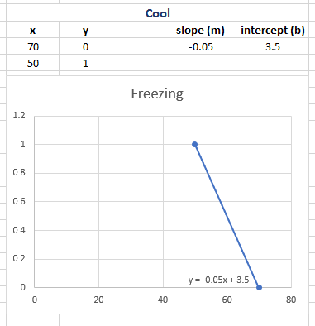
Temperature: Cool
CONSTANT
#define Coolup_Slope (0.05);
#define Coolup_Offset (-1.5);
#define Cooldown_Slope (-0.05);
#define Cooldown_Offset (3.5);

Slide 10
private final static double COOL_UP_SLOPE =0.05; private final static double COOL_UP_OFFSET =-1.5; private final static double COOL_DOWN_SLOPE =-0.05; private final static double COOL_DOWN_OFFSET =3.5;

Slide 11
double CoolMF (double temp)
{
double mf = 0;
if (((temp >= 0) && (temp < 30)) || (temp >= 70))
{
mf = 0;
}
else if((temp >= 30) && (temp < 50))
{
mf = (Coolup_Slope * temp) + Coolup_Offset;
}
else if((temp >= 50) && (temp < 70))
{
mf = (Cooldown_Slope * temp) + Cooldown_Offset;
}
return mf;
}
temp >= 50 && temp < 70
temp >= 30 && temp < 50
temp >= 0 && temp < 30
temp >= 70

Slide 12
public double coolGetMf(double temp){ double mf=0; if(((temp<30)&&(temp>=0))||(temp>=70)){ mf=0; } else if((temp>=30)&&(temp<50)){ mf=COOL_UP_SLOPE * temp + COOL_UP_OFFSET; } else if((temp>=50)&&(temp<70)){ mf=COOL_DOWN_SLOPE * temp + COOL_DOWN_OFFSET; } return mf; }//coolGetMf

Slide 13

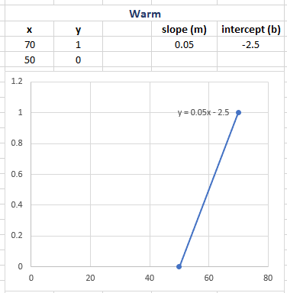
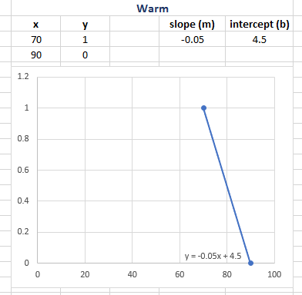
Temperature: Warm
CONSTANT
#define Warmup_Slope (0.05);
#define Warmup_Offset (-2.5);
#define Warmdown_Slope (-0.05);
#define Warmdown_Offset (4.5);

Slide 14
private final static double WARM_UP_SLOPE =0.05; private final static double WARM_UP_OFFSET =-2.5;
private final static double WARM_DOWN_SLOPE =-0.05; private final static double WARM_DOWN_OFFSET =4.5;

Slide 15
double WarmMF (double temp)
{
double mf = 0;
if (((temp >= 0) && (temp < 50)) || (temp >= 90))
{
mf = 0;
}
else if((temp >= 50) && (temp < 70))
{
mf = (Warmup_Slope * temp) + Warmup_Offset;
}
else if((temp >= 70) && (temp < 90))
{
mf = (Warmdown_Slope * temp) + Warmdown_Offset;
}
return mf;
}
temp >= 70 && temp < 90
temp >= 50 && temp < 70
temp >= 0 && temp < 50
temp >= 90

Slide 16
public double warmGetMf(double temp){ double mf=0; if(((temp<50)&&(temp>=0))||(temp>=90)){ mf=0; } else if((temp>=50)&&(temp<70)){ mf=WARM_UP_SLOPE * temp + WARM_UP_OFFSET; } else if((temp>=70)&&(temp<90)){ mf=WARM_DOWN_SLOPE * temp + WARM_DOWN_OFFSET; } return mf; }//warmGetMf

Slide 17

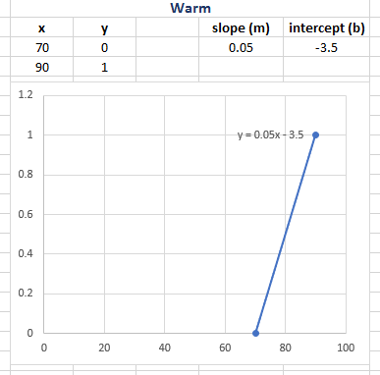
Temperature: Hot
HOT
CONSTANT
#define Hot_Slope (0.05);
#define Hot_Offset (-3.5);

Slide 18
private final static double HOT_SLOPE = 0.05; private final static double HOT_OFFSET =-3.5 ;

Slide 19
double HotMF (double temp)
{
double mf = 0;
if(temp >=90)
{
mf = 1;
}
else if ((temp < 70) && (temp>=0))
{
mf = 0;
}
else if((temp >= 70) && (temp < 90))
{
mf = (Hot_Slope * temp) + Hot_Offset;
}
return mf;
}
temp >=90
temp >= 70 && temp < 90
temp < 70 && temp>=0

Slide 20
public double hotGetMf(double temp){ double mf=0; if((temp<70)&&(temp>=0)){ mf=0; } else if(temp>=90){ mf=1; } else if((temp>=70)&&(temp<90)){ mf=HOT_SLOPE * temp + HOT_OFFSET; } return mf; }//hotGetMf

Slide 21
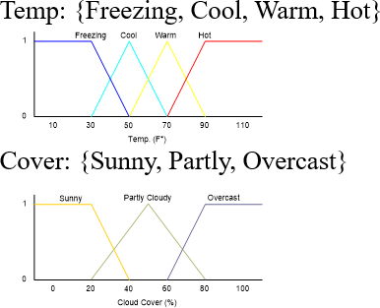
Cloud Cover

Slide 22

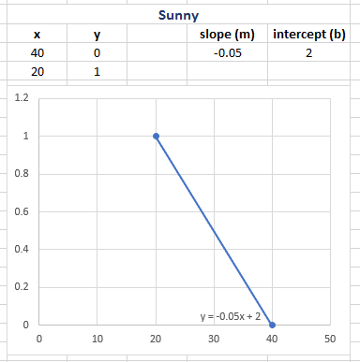
Cover: Sunny
CONSTANT
#define Sunny_Slope (-0.05);
#define Sunny_Offset (2);

Slide 23
private final static double SUNNY_SLOPE = -0.05; private final static double SUNNY_OFFSET = 2 ;

Slide 24
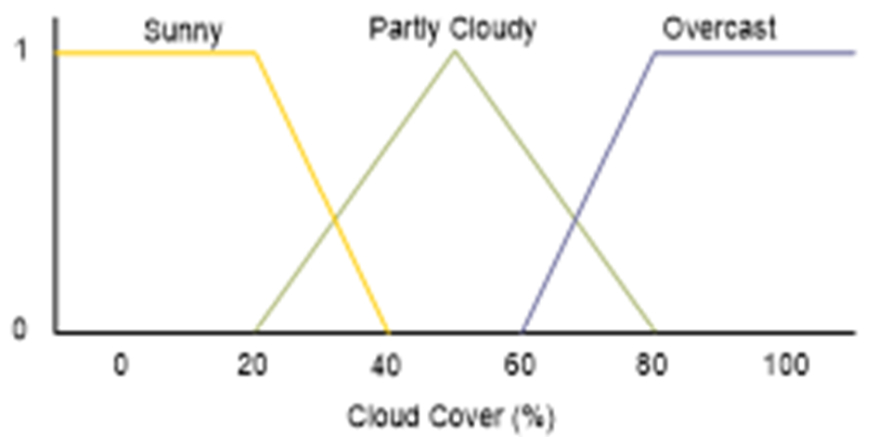
double SunnyMF (double cover)
{
double mf = 0;
if((cover >= 0) && (cover < 20))
{
mf = 1;
}
else if (cover >= 40)
{
mf = 0;
}
else if((cover >= 20) && (cover < 40))
{
mf = (Sunny_Slope * cover) + Sunny_Offset;
}
return mf;
}
cover >= 0 && cover < 20
cover >= 20 && cover < 40
cover >= 40

Slide 25
public double sunnyGetMf(double cover){ double mf=0; if((cover<20)&&(cover>=0)){ mf=1; } else if(cover>=40){ mf=0; } else if((cover>=20)&&(cover<40)){ mf=SUNNY_SLOPE * cover + SUNNY_OFFSET; } return mf; }//sunnyGetMf

Slide 26

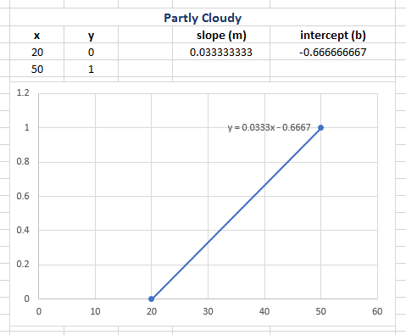
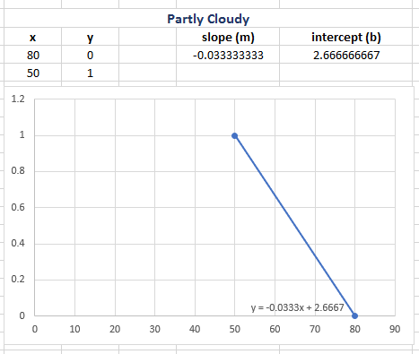
Cover: Partly
CONSTANT
#define PartlyUp_Slope (0.033333333);
#define PartlyUp_Offset (-0.666666667);
#define PartlyDown_Slope (-0.033333333);
#define PartlyDown_Offset (2.666666667);

Slide 27
private final static double PARTLY_UP_SLOPE =0.033333333; private final static double PARTLY_UP_OFFSET =-0.666666667;
private final static double PARTLY_DOWN_SLOPE =-0.033333333; private final static double PARTLY_DOWN_OFFSET =2.666666667;

Slide 28
double PartlyMF (double cover)
{
double mf = 0;
if (((cover >= 0) && (cover < 20)) || (cover >= 80))
{
mf = 0;
}
else if((cover >= 20) && (cover < 50))
{
mf = (PartlyUp_Slope * cover) + PartlyUp_Offset;
}
else if((cover >= 50) && (cover < 80))
{
mf = (PartlyDown_Slope * cover) + PartlyDown_Offset;
}
return mf;
}
cover >= 20 && cover < 50
cover >= 50 && cover < 80
cover >= 0 && cover < 20
cover >= 80

Slide 29
public double partlyGetMf(double cover){ double mf=0; if(((cover<20)&&(cover>=0))||(cover>=80)){ mf=0; } else if((cover>=20)&&(cover<50)){ mf=PARTLY_UP_SLOPE * cover + PARTLY_UP_OFFSET; } else if((cover>=50)&&(cover<80)){ mf=PARTLY_DOWN_SLOPE * cover + PARTLY_DOWN_OFFSET; } return mf; }//partlyGetMf

Slide 30


Cover: Overcast
CONSTANT
#define Overcast_Slope (0.05);
#define Overcast_Offset (-3);

Slide 31
private final static double OVERCAST_SLOPE = 0.05; private final static double OVERCAST_OFFSET = -3 ;

Slide 32
double OvercastMF (double cover)
{
double mf = 0;
if ((cover < 60) && (cover >= 0))
{
mf = 0;
}
else if(cover >= 80)
{
mf = 1;
}
else if((cover >= 60) && (cover < 80))
{
mf = (Overcast_Slope * cover) + Overcast_Offset;
}
return mf;
}
cover >= 80
cover >= 60 && cover < 80
cover < 60 && cover >= 0

Slide 33
public double overcastGetMf(double cover){ double mf=0; if((cover<60)&&(cover>=0)){ mf=0; } else if(cover>=80){ mf=1; } else if((cover>=60)&&(cover<80)){ mf=OVERCAST_SLOPE * cover + OVERCAST_OFFSET; } return mf; }//overcastGetMf

Slide 34

End

